Slide 1
?
Notes:
Who Am I. I know my name, but really, Who Am I? Why I am here? Treading a path that is only treaded by few. Doing things that were not dared by many. Deep Down, Who Am I?

Slide 2
Notes:
Maybe I am a rebel. The brave one, the one who relentlessly challenges the status quo to make a difference. The one who will not give up until the world is changed according to my vision. The one who will fight for his dream until the end. Yes, that’s me. I always wanted to make a difference, I have always been the crazy ones.

Slide 3
Notes:
From moving from moving to the United States while knowing very little English, to build a web application from scratch without any coding background. I have always been the one who strive to do the impossible, I have always been the one who strive to be perfect.

Slide 4
Notes:
In order to pursue my dream and achieve perfection, I would not sleep, eat, and will work all day to make sure that all my works are not only perfect, but also perfectly different. Yes, a rebel, that’s who I am.

Slide 5
Notes:
But Then a sudden chill came through my spine. I realized that I do what I do not because that I am a brave rebel, but because that I am afraid. Instead of motivated by my rebellious nature, I am motivated by fear: The fear of failure, the fear of disapproval, and even fear of being afraid.

Slide 6
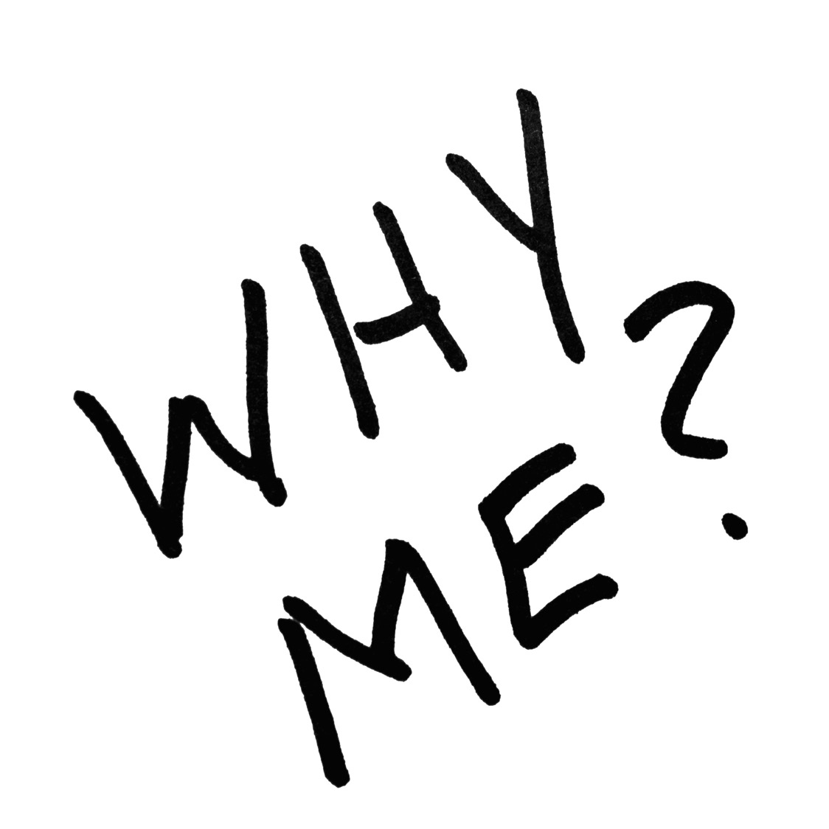
Notes:
I have been chased after by those fear for all of my life. I came to the United States because I am afraid of being mocked by my peers for not making to the best high school. I learned coding and development because I am afraid that I might be left behind by the digital revolution. I move because I have to, not because I want to.

Slide 7
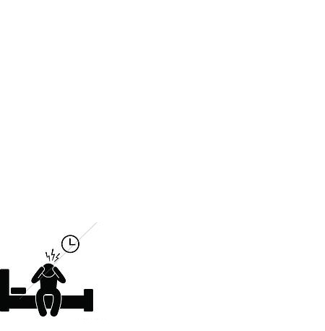
Notes:
Time after time, I found myself couldn’t fall asleep in the middle of the night because I was too frustrated by how far away I am from my ideal self, of how much better I could have become. In the darkness, alone, I am scared. Maybe I am not a rebel after all, maybe I am just a coward.

Slide 8
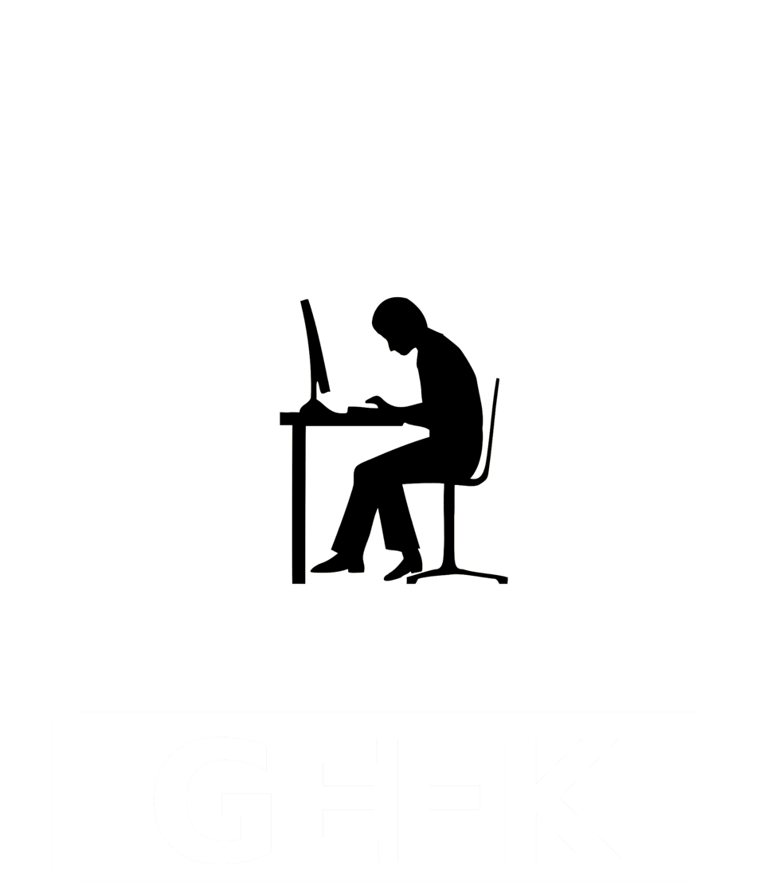
Notes:
Maybe I am a loner, the nerdy one. The one that blocks the world from myself because it scares me so much that I would much rather interact with machine and books. The one that distance myself from people because I am afraid that one day, someone might hurt me.

Slide 9
Notes:
Those of you who have interacted with me probably have realized at this point that I am really passionate about my work and what I do, espically the field of data science and entreprenuership and I can talk about those topics and work for days without being tired or stressed.

Slide 10
Notes:
But, when comes to interacting and socializing with people, perhaps due to cultural differences, perhaps due to language barriers, I am rather shy and introverted. Time after time, I found myself alone in a corner in a party, resorting to playing with my phones. Maybe, I am just the one who deserves to be alone.

Slide 11
Notes:
But then I realized that the very reason I am here is because I am extremely interested in and care about the welfare about people around the world, about how people think, behave, and interact with each other, how they could be so different yet so similar.

Slide 12
Notes:
I also deeply believe in each individual’s ability to make a different in other people’s lives. And the reason I am here is because I want to empower people who are powerless and disadvantaged using the newest technology, and lift them out of poverty and injustice they are currently in.

Slide 13
Notes:
Eventually, I want to create a world that is peaceful and harmnous, with technologies working alongside of people to improve their lives and enable them to do whatever they wish, thus creating a society of true liberty. So Maybe, I do care about people after all, maybe I not a loner.

Slide 14
?
Notes:
The questions mark appears again, returning us to the original question. But the more I search for Who I really am, the more and more lost I have become. The more questions I ask, the more and more deeply I have sunk into the dark abyss of confusion.

Slide 15
Notes:
So, in the end, who Am I? Am I a rebel, or a coward; A loner, or someone who cares? Maybe I am All, maybe I am none, maybe, after all, this question do not deserves an answer, maybe, the reason I am here, is because, I am me.

Slide 16
Me

